Slide 1

Plumas County
American Rescue Plan Act:
Coronavirus State and Local Fiscal Recovery Funds Program
Zachary Gately
Grant Manager
County Administrative Office
zacharygately@countyofplumas.com

Slide 2

Overview of Program
The American Rescue Plan (ARPA) provided $350 billion in emergency funding for eligible state, local, territorial, and Tribal governments to respond to the COVID-19 emergency and bring back jobs through the Coronavirus State and Local Fiscal Recovery Funds (SLFRF).
Plumas County received the ARPA Allocation from the US Treasury at the end of 2021 for a total of $3,653,039.
These funds are to be fully allocated by December 31, 2024, and use by December 31, 2026.

Slide 3
Budget: Adopted May 12, 2022
Human Resources: $1,274,000
COVID-19 Sick Time Reimbursement: $200,000
Essential Worker Stipend: $774,000
ARPA Grant Manager (2 years): $300,000
Sheriff’s Office: $707,521
Two New ADA Prisoner Transport Vans: $235,950
New Computer System: $471,571
Engineering: $286,000
Beckwourth Pump Repairs: $33,000
Blairsden Bridge Project: $253,000
Library: $24,794
Hotspots, ebooks and tutoring
Business/CBO Grants: $540,000
Broadband: $400,000
Plumas County Broadband Study: $25,000
County IT: $300,000
Cybersecurity: $182,000
Software: $58,100
Hardware: $59,900
Facilities Services: $70,765
COVID-19 Janitorial Services: $64,765
Portable Air Scrubbers: $6,000
County Administrative Office: $49,959
TOT Audit Services: $9,959
California Health Collaborative ARPA Management: $40,000

Slide 4
Budget: Progress of Obligated Funds*
Human Resources: $1,274,000 $106,000
COVID-19 Sick Time Reimbursement: $200,000
Essential Worker Stipend: $774,000 $106,000
ARPA Grant Manager (2 years): $300,000
Sheriff’s Office: $707,521 $0
Two New ADA Prisoner Transport Vans: $235,950
New Computer System: $471,571
Engineering: $286,000 $0
Beckwourth Pump Repairs: $33,000
Blairsden Bridge Project: $253,000
Library: $24,794 $0
Hotspots, Ebooks and tutoring (March 21, 2023)
Business/CBO Grants: $540,000 $0
Broadband: $400,000 $375,000
Plumas County Broadband Study: $25,000
County IT: $300,000 $0
Cybersecurity: $182,000
Software: $58,100
Hardware: $59,900
Facilities Services: $70,765 $0
COVID-19 Janitorial Services: $64,765
Portable Air Scrubbers: $6,000
County Administrative Office: $49,959 $0
TOT Audit Services: $9,959
California Health Collaborative ARPA Management: $40,000
Total available unallocated funds:
*Obligated means funds have a specific cost though funds may not have been spent yet

Slide 5
Human Resources: $1,274,000
Human Resources: $1,274,000
COVID-19 Sick Time Reimbursement: $200,000
Reimbursed employees out on sick leave during the COVID-19 Pandemic during part of 21/22
Essential Worker Stipend: $774,000
Provided two stipends payouts to permanent employees
$1,500 – Total $447,000
$1,000 – Total $221,000
Remaining $106,000
ARPA Grant Manager (2 years): $300,000
Approx. $125,000 has been used through Dec 31, 2023

Slide 6
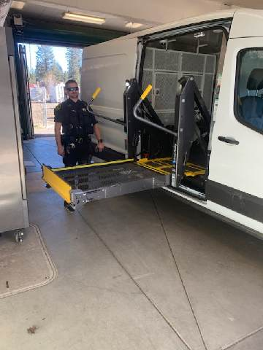
Sheriff’s Office: $707,521
Sheriff’s Office: $707,521
Two New ADA Prisoner Transport Vans (2): $235,950
Received and working well
Cost was $6000 over budget however the Sheriff’s Office was able to cover the difference.
New Computer System: $471,571
The project is currently underway
25% has been paid to the company as work has started and this is inline with the pay schedule of the contract.

Slide 7
Engineering: $286,000
Engineering: $286,000
Beckwourth Pump Repairs: $33,000
Due to increase of wipes and other non-flush-ables, as well as the storms of winter/spring 2023, this project went over budget. Additional costs were covered by LATCF funds to complete these repairs.
Blairsden Bridge Project: $253,000
Currently the project is underway with work beginning this year. ARPA is covering the cost of water and sewer line conduits on the bridge.

Slide 8

Library: $24,794
Library: $24,794
Spread across hotspots, ebooks and tutoring
On March 21, 2023, the Library Director asked to split the remaining tutoring funds to hotspots and ebooks as the State of California paid for the tutoring program after this budget was finalized

Slide 9
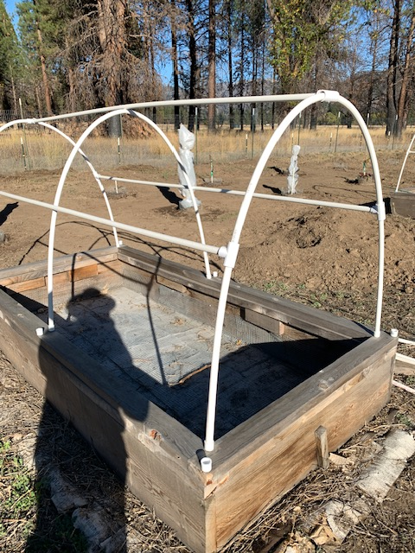
Business/CBO Grants: $540,000
ARPA Community Grant Program
Open to for profit and non-profit
Total of 105 applicants with 55 recipients
District 1: 6
District 2: 11
District 3: 7
District 4: 26
District 5: 5
A few are still processing due to a number of different factors: county staff capacity and awardee responsiveness
Fully prescribed and all $540,000 went directly to businesses

Slide 10

Broadband
Plumas County Broadband Study
$125,000 total cost, Plumas matched $25,000
26 other Counties in California participated
Meant to be a resource document
Local Agency Technical Assistance (LATA)
Provides Funding that will result in low-level, construction ready network design for identified project areas
Done operations and site visits were conducted under this program in Dec and Jan
Federal Fund Account Last Mile
Golden State Connect Authority has applied, not awarded
If awarded, approx. 40 miles of open access, last mile, municipal fiber broadband network.

Slide 11

Facilities Services: $70,765
Facilities Services: $70,765
COVID-19 Janitorial Services: $64,765
Paid for extra Janitorial Services during COVID-19 Pandemic
Portable Air Scrubbers: $6,000
Purchased five (5) portable air scrubbers to be used in county offices as needed when there is a need (i.e., smoke, illness, etc.)
Purchased model already in use at Plumas County for convenience of maintenance

Slide 12
County IT: $300,000
County IT: $300,000
Cybersecurity: $182,000
Used for part of the cyber attack
Used in training of staff
Used in programs for aiding cybersecurity
Software: $58,100
CivicClerk and other back-end improvements
Hardware: $59,900
DROC Conferencing system
BOS meeting room improvements
*in lieu of picture, we can look at what is allowing this meeting to happen virtually such as microphones and camera

Slide 13
County Administrative Office: $49,959
County Administrative Office: $49,959
TOT Audit Services: $9,959
ARPA paid for the annual services of Granicus to assist in TOT
California Health Collaborative ARPA Management: $40,000
DeAnne Blankenship assisted Plumas County at the beginning of this process before the hand-off to the Grant Manger

Slide 14
Budget: Progress of Allocated Funds*
Human Resources: $1,274,000 $106,000
COVID-19 Sick Time Reimbursement: $200,000
Essential Worker Stipend: $774,000 $106,000
ARPA Grant Manager (2 years): $300,000
Sheriff’s Office: $707,521 $0
Two New ADA Prisoner Transport Vans: $235,950
New Computer System: $471,571
Engineering: $286,000 $0
Beckwourth Pump Repairs: $33,000
Blairsden Bridge Project: $253,000
Library: $24,794 $0
Hotspots, Ebooks and tutoring (March 21, 2023)
Business/CBO Grants: $540,000 $0
Broadband: $400,000 $375,000
Plumas County Broadband Study: $25,000
County IT: $300,000 $0
Cybersecurity: $182,000
Software: $58,100
Hardware: $59,900
Facilities Services: $70,765 $0
COVID-19 Janitorial Services: $64,765
Portable Air Scrubbers: $6,000
County Administrative Office: $49,959 $0
TOT Audit Services: $9,959
California Health Collaborative ARPA Management: $40,000
Total available unallocated funds: $481,000
*Allocated means funds have a specific cost though funds may not have been spent yet

Slide 15
Next steps
Reporting
The annual reporting period closes March 31, 2024, and final report due April 30,2024.
A presentation will be given to the BOS after the final report is submitted.
Discussion around unobligated funds will be initiated at the presentation.
Thank you!
Big thank you to the departments that received funds: Human Resources, Sheriff’s Office, Engineering/Public Works, Library, Facility Services, and IT.
Also thank you to the offices of County Counsel, Auditor-Controller, Treasurer/Tax Collector, and Assessor for assistance throughout the process.
And to you, the BOS, thank you for your direction on the program.

