Slide 1


Plumas County Salary Study
Study to be completed by:

Slide 2
Current Status
RGS has determined new comparison counties
RGS and the County have determined Benchmark positions
  This took longer than expected as there are several positions that the county has not used or updated in several years, and so HR worked with the Department Heads to remove those from the salary study.
These are essential first steps, as they provide the framework for the salary study. RGS will look for positions similar to Plumas’s Benchmark positions at the comparison counties, and use that to build out compensation for each classification group.
  (Ex. RGS will find comps for Social Worker II, then use that to determine salaries for Social Worker I, Social Worker III, Senior Social Worker, etc.)

Slide 3
Comparison Counties
RGS has Identified Nine Comparison Counties
  These counties were identified using a point system, where different points were assigned based on similarities in the following categories
    Distance
    Cost of Living
    Population
    Number of allocated positions (FTEs)
    County Budget

Slide 4
Comparison Counties
AGENCY | DISTANCE | Points | Cost/ Living | Points | POP Served | Points | # EES (FTE) | Points | BUDGET | Points | TOTAL
PLUMAS COUNTY | 0.0 | 5 | 102.5 | 5 | 22,000 | 5 | 423.5 | 5 | $158,460,450 | 5 | 25
Colusa County | 122.0 | 3 | 100.0 | 5 | 22,293 | 5 | 428.7 | 5 | $133,248,380 | 3 | 21
Trinity County | 171.9 | 3 | 101.0 | 5 | 15,642 | 3 | 387.8 | 5 | $144,790,291 | 5 | 21
Inyo County | 67.0 | 5 | 88.7 | 0 | 19,000 | 5 | 478.0 | 3 | $170,508,201 | 3 | 16
Lassen County | 324.0 | 0 | 112.7 | 1 | 32,730 | 3 | 445.8 | 5 | $155,751,652 | 5 | 14
Mono County | 192.8 | 3 | 124.5 | 0 | 12,991 | 3 | 325.0 | 3 | $164,119,888 | 5 | 14
Amador County | 192.0 | 3 | 111.4 | 1 | 42,447 | 1 | 432.0 | 5 | $130,115,539 | 3 | 13
Glenn County | 108.0 | 3 | 98.7 | 5 | 28,736 | 3 | 565.5 | 1 | $191,727,579 | 1 | 13
Del Norte County | 340.0 | 0 | 93.3 | 3 | 27,743 | 3 | 424.0 | 5 | $242,655,723 | 0 | 11
Sierra County | 57.3 | 5 | 101.1 | 5 | 3,113 | 0 | 130.0 | 0 | $50,983,151 | 0 | 10
Tehama County | 112.4 | 3 | 100.8 | 5 | 64,451 | 0 | 908.7 | 0 | $280,495,954 | 0 | 8
Sutter County | 104.3 | 3 | 114.1 | 1 | 98,545 | 0 | 1089.7 | 0 | $477,500,000 | 0 | 4
Tuolumne County | 238.8 | 1 | 109.8 | 3 | 53,893 | 0 | 749.6 | 0 | $302,690,260 | 0 | 4
Alpine County | 146.0 | 3 | 121.6 | 0 | 1,045 | 0 | 92.2 | 0 | $50,983,026 | 0 | 3
San Benito County | 293.9 | 1 | 170.1 | 0 | 69,159 | 0 | 595.3 | 1 | $339,400,000 | 0 | 2
Calaveras County | 211.0 | 1 | 120.4 | 0 | 45,995 | - | 651.0 | 0 | $383,739,139 | 0 | 1
Modoc County | 201.9 | 1 | 80.7 | 0 | 8,491 | 0 | 244.4 | 0 | $28,090,529 | 0 | 1

Slide 5
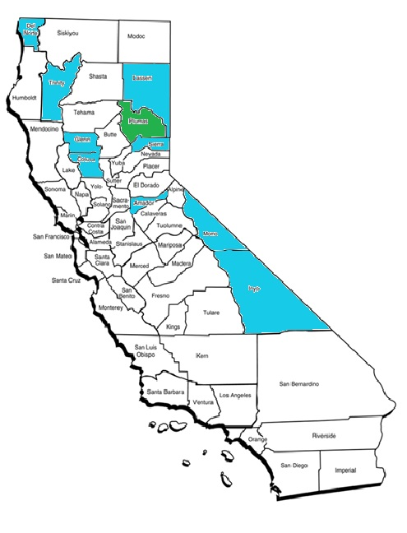
Comparison Counties
Colusa
Trinity
Inyo
Lassen
Mono
Amador
Glenn
Del Norte
Sierra

